Slide 1


Chapter 5: Homework
1. Using the following String Reverse program as a starting point,
  #1: Modify the program so the user can input a string containing between 1 and 50 characters.
  #2: Modify the program so it inputs a list of 32-bit integers from the user, and then displays the integers in reverse order. The number of the elements in the list is 10.
Submit the source code files of the two modified programs and the screenshots of the console input/output of these programs.
Irvine, Kip R. Assembly Language for Intel-Based Computers 5/e, 2007.

Slide 2

Chapter 5: Homework
2. Write a program that does the following:
  1) Assigns integer values to EAX, EBX, ECX, EDX, ESI, and EDI
  2) Uses PUSHAD to push the general-purpose registers on the stack
  3) Using a loop, your program should pop each integer from the stack and display it on the screen
Submit the source code file of your program and the screenshot of the console output of your program. Explain the sequence of the values of the console output.
Irvine, Kip R. Assembly Language for Intel-Based Computers 5/e, 2007.

Slide 3

Chapter 5: Homework
3. The RandomRange procedure from the Irvine32 library generates a pseudorandom integer between 0 and N - 1. Your task is to create an improved version that generates an integer between M and N. Let the caller pass M in EAX and N in EBX. If we call the procedure BetterRandomRange, the following code is a sample test:
mov eax,-300 ; lower bound
mov ebx,100 ; upper bound
call BetterRandomRange
Write a short test program that calls BetterRandomRange from a loop that repeats 10 times. Display each randomly generated value.
Submit the source code file of your program and the screenshot of the console output of your program.
Irvine, Kip R. Assembly Language for Intel-Based Computers 5/e, 2007.

Slide 4
Assembly Language for Intel-Based Computers, 6th Edition
Kip R. Irvine
Chapter 6: Conditional Processing
Slides prepared by the author
Revision date: June 4, 2006
(c) Pearson Education, 2006-2007. All rights reserved. You may modify and copy this slide show for your personal use, or for use in the classroom, as long as this copyright statement, the author's name, and the title are not changed.

Slide 5
Chapter Overview
Boolean and Comparison Instructions
Conditional Jumps
Conditional Loop Instructions
Conditional Structures
Application: Finite-State Machines
Decision Directives
Irvine, Kip R. Assembly Language for Intel-Based Computers 5/e, 2007.

Slide 6
Boolean and Comparison Instructions
CPU Status Flags
AND Instruction
OR Instruction
XOR Instruction
NOT Instruction
Applications
TEST Instruction
CMP Instruction
Irvine, Kip R. Assembly Language for Intel-Based Computers 5/e, 2007.

Slide 7
Status Flags - Review
The Zero flag is set when the result of an operation equals zero.
The Carry flag is set when an instruction generates a result that is too large (or too small) for the destination operand.
The Sign flag is set if the destination operand is negative, and it is clear if the destination operand is positive.
The Overflow flag is set when an instruction generates an invalid signed result (bit 7 carry is XORed with bit 6 Carry for addition).
The Parity flag is set when an instruction generates an even number of 1 bits in the low byte of the destination operand.
The Auxiliary Carry flag is set when an operation produces a carry out from bit 3 to bit 4
Irvine, Kip R. Assembly Language for Intel-Based Computers 5/e, 2007.

Slide 8


AND Instruction
Performs a Boolean AND operation between each pair of matching bits in two operands
Always clears the Overflow and Carry flags and modifies the Sign, Zero, and Parity flags
Syntax:
    AND destination, source
  (same operand types as MOV)
AND
The AND instruction lets you clear 1 or more bits in an operand without affecting other bits.
Irvine, Kip R. Assembly Language for Intel-Based Computers 5/e, 2007.

Slide 9


OR Instruction
Performs a Boolean OR operation between each pair of matching bits in two operands
Syntax:
    OR destination, source
OR
The OR instruction is particularly useful when you need to set 1 or more bits in an operand without affecting any other bits.
Irvine, Kip R. Assembly Language for Intel-Based Computers 5/e, 2007.

Slide 10

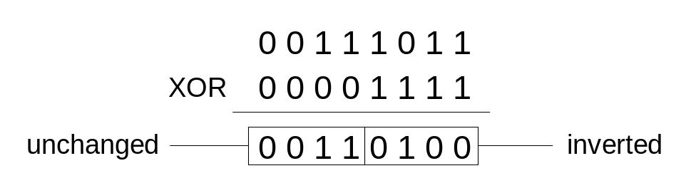
XOR Instruction
Performs a Boolean exclusive-OR operation between each pair of matching bits in two operands
Syntax:
    XOR destination, source
XOR
XOR is a useful way to toggle (invert) the bits in an operand.
Irvine, Kip R. Assembly Language for Intel-Based Computers 5/e, 2007.

Slide 11

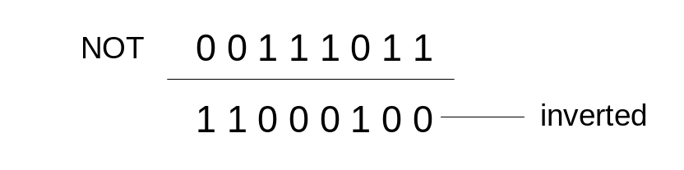
NOT Instruction
Performs a Boolean NOT operation on a single destination operand
Syntax:
    NOT destination
NOT
Irvine, Kip R. Assembly Language for Intel-Based Computers 5/e, 2007.

Slide 12
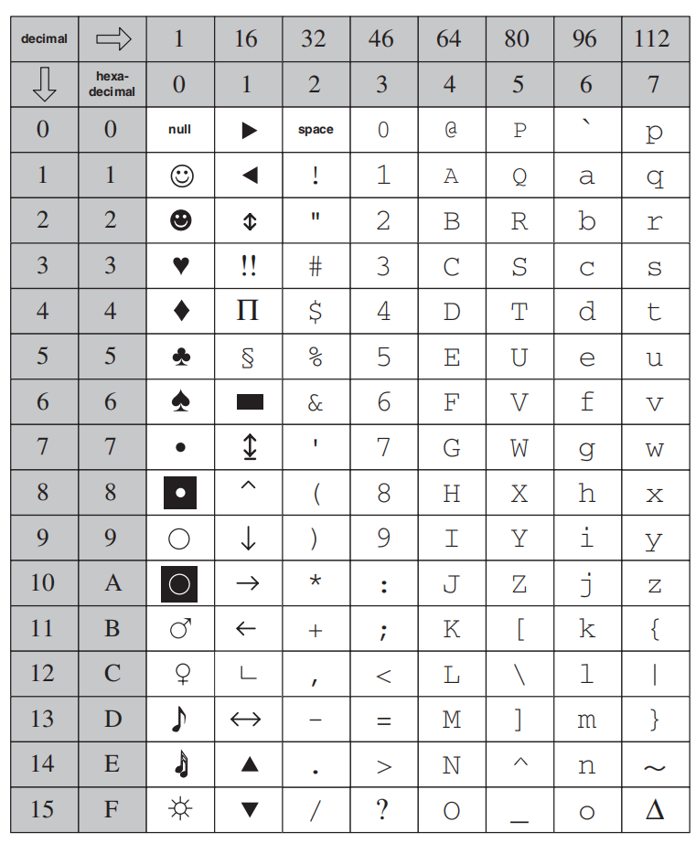
Applications (1 of 2)
Task: Convert the character in AL to upper case.
Solution: Use the AND instruction to clear bit 5.
mov al,'a' ; AL = 01100001b
and al,11011111b ; AL = 01000001b
Irvine, Kip R. Assembly Language for Intel-Based Computers 5/e, 2007.

Slide 13
Applications (2 of 2)
Task: Convert a binary decimal byte into its equivalent ASCII decimal digit.
Solution: Use the OR instruction to set bits 4 and 5.
mov al,6 ; AL = 00000110b
or al,00110000b ; AL = 00110110b
The ASCII digit '6' = 00110110b
Irvine, Kip R. Assembly Language for Intel-Based Computers 5/e, 2007.

Slide 14
TEST Instruction
Performs a nondestructive AND operation between each pair of matching bits in two operands
No operands are modified, but the flags are affected as AND.
Syntax:
    TEST destination, source
Irvine, Kip R. Assembly Language for Intel-Based Computers 5/e, 2007.

Slide 15
Logical Boolean Expression
At the heart of any boolean expression is some type of comparison
Example:
if A > B then ...
while X > 0 and X < 200 ...
if check_for_error( N ) = true then
cmp op1,op2
jcond label
Irvine, Kip R. Assembly Language for Intel-Based Computers 5/e, 2007.

Slide 16
CMP Instruction (1 of 3)
performs a nondestructive subtraction of a source operand from a destination operand (destination operand is not changed)
Syntax: CMP destination, source
Example: destination == source
mov al,5
cmp al,5 ; Zero flag set
Example: destination < source
mov al,4
cmp al,5 ; Carry flag set
Irvine, Kip R. Assembly Language for Intel-Based Computers 5/e, 2007.

Slide 17
CMP Instruction (2 of 3)
Example: destination > source
mov al,6
cmp al,5 ; ZF = 0, CF = 0
(both the Zero and Carry flags are clear)
Irvine, Kip R. Assembly Language for Intel-Based Computers 5/e, 2007.

Slide 18
CMP Instruction (3 of 3)
The comparisons shown here are performed with signed integers.
Example: destination > source
mov al,5
cmp al,-2 ; Sign flag == Overflow flag
Example: destination < source
mov al,-1
cmp al,5 ; Sign flag != Overflow flag
Irvine, Kip R. Assembly Language for Intel-Based Computers 5/e, 2007.

Slide 19
What's Next
Boolean and Comparison Instructions
Conditional Jumps
Conditional Loop Instructions
Conditional Structures
Application: Finite-State Machines
Decision Directives
Irvine, Kip R. Assembly Language for Intel-Based Computers 5/e, 2007.

Slide 20
Conditional Jumps
Jumps Based On . . .
  Specific flags
  Equality
  Unsigned comparisons
  Signed Comparisons
Applications
Encrypting a String
Bit Test (BT) Instruction
Irvine, Kip R. Assembly Language for Intel-Based Computers 5/e, 2007.

Slide 21
Jcond Instruction
A conditional jump instruction branches to a label when specific register or flag conditions are met
Examples:
  JB, JC jump to a label if the Carry flag is set
  JE, JZ jump to a label if the Zero flag is set
  JS jumps to a label if the Sign flag is set
  JNE, JNZ jump to a label if the Zero flag is clear
  JECXZ jumps to a label if ECX equals 0
Irvine, Kip R. Assembly Language for Intel-Based Computers 5/e, 2007.

Slide 22
Jcond Ranges
Prior to the 386:
  jump must be within –128 to +127 bytes from current location counter
IA-32 processors:
  32-bit offset permits jump anywhere in memory
Irvine, Kip R. Assembly Language for Intel-Based Computers 5/e, 2007.

Slide 23
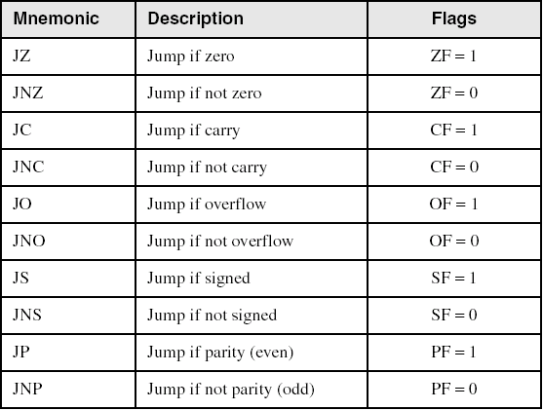
Jumps Based on Specific Flags
Irvine, Kip R. Assembly Language for Intel-Based Computers 5/e, 2007.

Slide 24
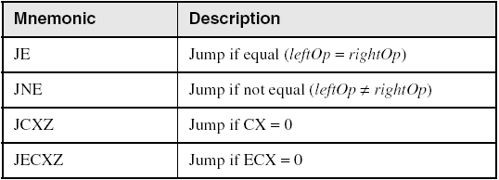
Jumps Based on Equality
Irvine, Kip R. Assembly Language for Intel-Based Computers 5/e, 2007.

Slide 25
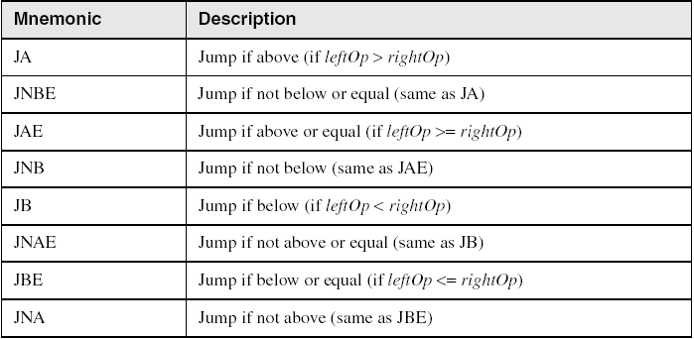
Jumps Based on Unsigned Comparisons
Irvine, Kip R. Assembly Language for Intel-Based Computers 5/e, 2007.

Slide 26
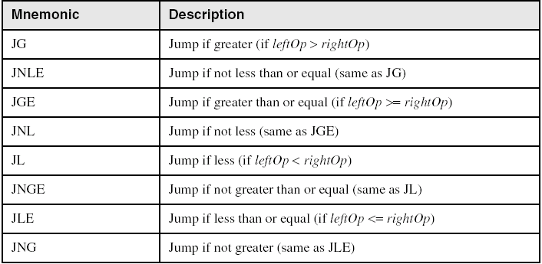
Jumps Based on Signed Comparisons
Irvine, Kip R. Assembly Language for Intel-Based Computers 5/e, 2007.

Slide 27
Applications (1 of 6)
Task: Jump to a label if unsigned EAX is greater than EBX
Solution: Use CMP, followed by JA
cmp eax,ebx
ja Larger
Task: Jump to a label if signed EAX is greater than EBX
Solution: Use CMP, followed by JG
cmp eax,ebx
jg Greater
Irvine, Kip R. Assembly Language for Intel-Based Computers 5/e, 2007.

Slide 28
Applications (2 of 6)
Jump to label L1 if unsigned EAX is less than or equal to Val1
cmp eax,Val1
jbe L1 ; below or equal
Jump to label L1 if signed EAX is less than or equal to Val1
cmp eax,Val1
jle L1
Irvine, Kip R. Assembly Language for Intel-Based Computers 5/e, 2007.

Slide 29
Applications (3 of 6)
Compare unsigned AX to BX, and copy the larger of the two into a variable named Large
  mov Large,bx
  cmp ax,bx
  jna Next
  mov Large,ax
Next:
  cmp ax,bx
  jna Next
  mov Large,ax
Next: mov Large,bx
Compare signed AX to BX, and copy the smaller of the two into a variable named Small
  mov Small,ax
  cmp bx,ax
  jnl Next
  mov Small,bx
Next:
Irvine, Kip R. Assembly Language for Intel-Based Computers 5/e, 2007.

Slide 30
Applications (4 of 6)
Jump to label L1 if the memory word pointed to by ESI equals Zero
  cmp WORD PTR [esi],0
  je L1
Jump to label L2 if the doubleword in memory pointed to by EDI is even
test DWORD PTR [edi],1
jz L2
Irvine, Kip R. Assembly Language for Intel-Based Computers 5/e, 2007.

Slide 31
Applications (5 of 6)
Task: Jump to label L1 if bits 0, 1, and 3 in AL are all set.
Solution: Clear all bits except bits 0, 1,and 3. Then compare the result with 00001011 binary.
and al,00001011b ; clear unwanted bits
cmp al,00001011b ; check remaining bits
je L1 ; all set? jump to L1
Irvine, Kip R. Assembly Language for Intel-Based Computers 5/e, 2007.

Slide 32
Applications (6 of 6)
Task: Jump to a label if the value in AL is not zero.
Solution: OR the byte with itself, then use the JNZ (jump if not zero) instruction.
or al,al
jnz IsNotZero ; jump if not zero
ORing any number with itself does not change its value.
Irvine, Kip R. Assembly Language for Intel-Based Computers 5/e, 2007.

Slide 33
Your turn . . .
Write code that jumps to label L1 if either bit 4, 5, or 6 is set in the BL register.
Write code that jumps to label L1 if bits 4, 5, and 6 are all set in the BL register.
Write code that jumps to label L1 if EAX is negative.
Write code that jumps to label L1 if the signed result of the expression (EBX – ECX) is greater than zero.
Irvine, Kip R. Assembly Language for Intel-Based Computers 5/e, 2007.

Slide 34
Encrypting a String
The following loop uses the XOR instruction to transform every character in a string into a new value.
KEY = 239 ; can be any byte value
BUFMAX = 128
.data
buffer BYTE BUFMAX+1 DUP(0)
bufSize DWORD BUFMAX
.code
  mov ecx,bufSize ; loop counter
  mov esi,0 ; index 0 in buffer
L1:
  xor buffer[esi],KEY ; translate a byte
  inc esi ; point to next byte
  loop L1
Irvine, Kip R. Assembly Language for Intel-Based Computers 5/e, 2007.

Slide 35

String Encryption Program
Tasks:
  Input a message (string) from the user
  Encrypt the message
  Display the encrypted message
  Decrypt the message
  Display the decrypted message
View the Encrypt.asm program's source code. Sample output:
Enter the plain text: Attack at dawn.
Cipher text: «¢¢Äîä-Ä¢-ïÄÿü-Gs
Decrypted: Attack at dawn.
Irvine, Kip R. Assembly Language for Intel-Based Computers 5/e, 2007.

Slide 36
BT (Bit Test) Instruction
Copies bit n from an operand into the Carry flag
Syntax: BT bitBase, n
  bitBase may be r/m16 or r/m32
  n may be r16, r32, or imm8
Example: jump to label L1 if bit 9 is set in the AX register:
bt AX,9 ; CF = bit 9
jc L1 ; jump if Carry
Irvine, Kip R. Assembly Language for Intel-Based Computers 5/e, 2007.

Slide 37
What's Next
Boolean and Comparison Instructions
Conditional Jumps
Conditional Loop Instructions
Conditional Structures
Application: Finite-State Machines
Decision Directives
Irvine, Kip R. Assembly Language for Intel-Based Computers 5/e, 2007.

Slide 38
Conditional Loop Instructions
LOOPZ and LOOPE
LOOPNZ and LOOPNE
Irvine, Kip R. Assembly Language for Intel-Based Computers 5/e, 2007.

Slide 39
LOOPZ and LOOPE
Syntax:
  LOOPE destination
  LOOPZ destination
Logic:
  ECX ← ECX – 1 (this operation does not affect ZF)
  if ECX > 0 and ZF=1, jump to destination
Useful when scanning an array for the first element that does not match a given value.
Irvine, Kip R. Assembly Language for Intel-Based Computers 5/e, 2007.

Slide 40
LOOPNZ and LOOPNE
LOOPNZ (LOOPNE) is a conditional loop instruction
Syntax:
LOOPNZ destination
LOOPNE destination
Logic:
  ECX ← ECX – 1; (this operation does not affect ZF)
  if ECX > 0 and ZF=0, jump to destination
Useful when scanning an array for the first element that matches a given value.
Irvine, Kip R. Assembly Language for Intel-Based Computers 5/e, 2007.

Slide 41
LOOPNZ Example
The following code finds the first positive value in an array:
.data
array SWORD -3,-6,-1,-10,10,30,40,4
sentinel SWORD 0
.code
  mov esi,OFFSET array
  mov ecx,LENGTHOF array
next:
  test WORD PTR [esi],8000h ; test sign bit
  pushfd ; push flags on stack
  add esi,TYPE array
  popfd ; pop flags from stack
  loopnz next ; continue loop
  jnz quit ; none found
  sub esi,TYPE array ; ESI points to value
quit:
Irvine, Kip R. Assembly Language for Intel-Based Computers 5/e, 2007.

Slide 42
Your turn . . .
Locate the first nonzero value in the array. If none is found, let ESI point to the sentinel value:
.data
array SWORD 50 DUP(?)
sentinel SWORD 0FFFFh
.code
  mov esi,OFFSET array
  mov ecx,LENGTHOF array
L1: cmp WORD PTR [esi],0 ; check for zero
(fill in your code here)
quit:
Irvine, Kip R. Assembly Language for Intel-Based Computers 5/e, 2007.

Slide 43
. . . (solution)
.data
array SWORD 50 DUP(?)
sentinel SWORD 0FFFFh
.code
  mov esi,OFFSET array
  mov ecx,LENGTHOF array
L1: cmp WORD PTR [esi],0 ; check for zero
  pushfd ; push flags on stack
  add esi,TYPE array
  popfd ; pop flags from stack
  loope L1 ; continue loop
  je quit ; none found
  sub esi,TYPE array ; ESI points to value
quit:
Irvine, Kip R. Assembly Language for Intel-Based Computers 5/e, 2007.

Slide 44

To Be Continued
Irvine, Kip R. Assembly Language for Intel-Based Computers 5/e, 2007.

